Slide 1
Genome Extraction 25.08.2020

Slide 2
Map of actions (hidden change to visible change) Map: sample →hidden change → visible change
Hidden change
Visible change
Sampel index
Hidden change
Visible change
.
.
.
Hidden change
Visible change
N samples
Hidden change
Visible change
Sampel index
Hidden change
Visible change
Hidden change
Visible change

Slide 3
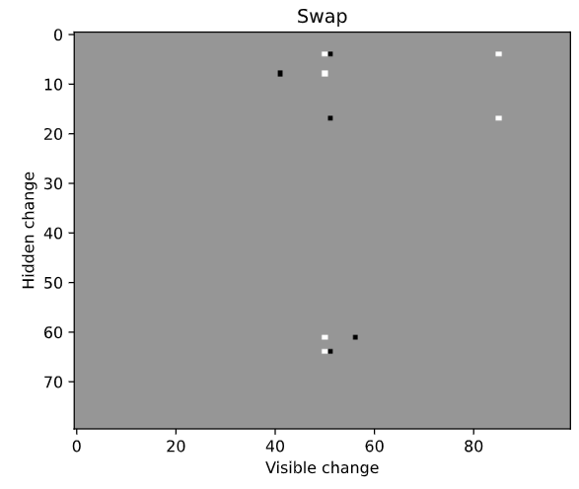
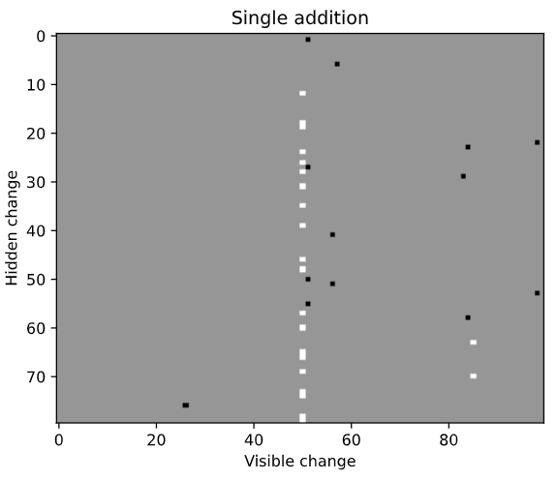
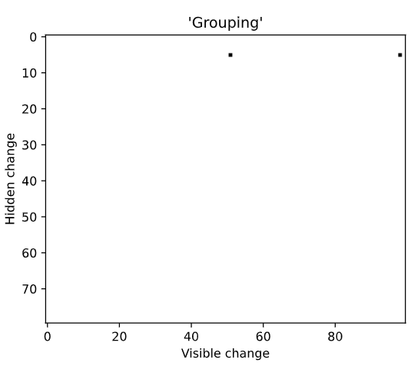
Categorization (swap, single add, group)
Different signs
1 -1 1 -1 : Reference solution
- -1 -1 1 1 : Modyfied solution
One non zero
2 0 0 -2 : Result
The same signs
Exclusion
Inclusion

Slide 4
Map: hidden change (in one category) → visible change → samples where it occured
visible change
List of samples with such change
.
.
.
Hidden change
.
.
.
visible change
List of samples with such change
Hidden changes
visible change
List of samples with such change
.
.
.
Hidden change
visible change
List of samples with such change

Slide 5
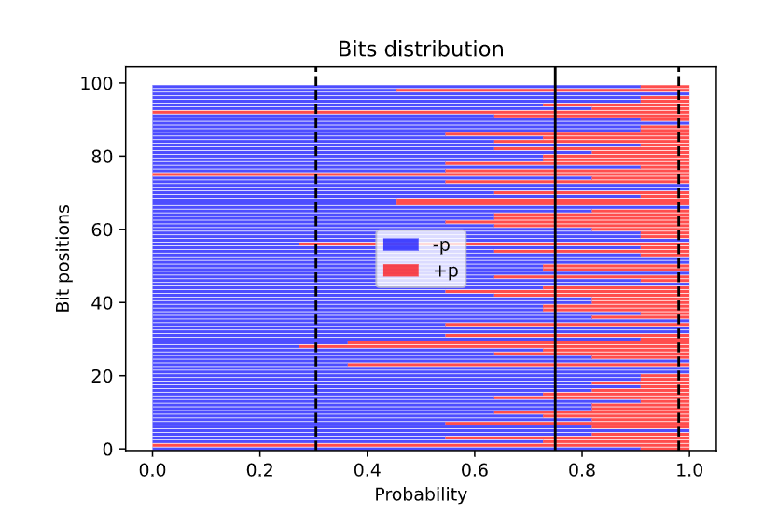
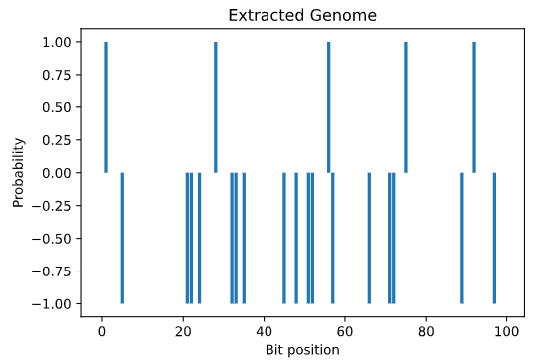
Genome extraction for one particular change
Hidden change
Visible change
Check bits distribution
List of samples
with such change
0.98 (fixed value, usually)
Mean
Mean – ceof (2) * std

Slide 6
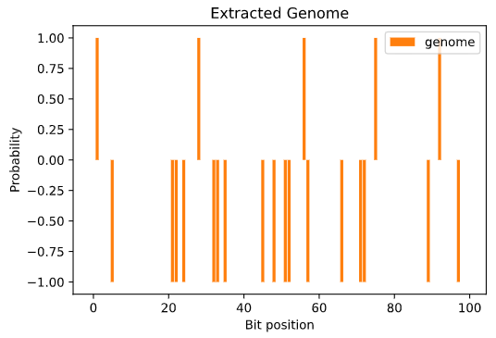
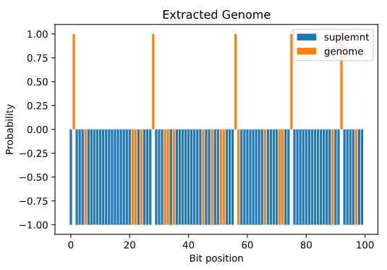
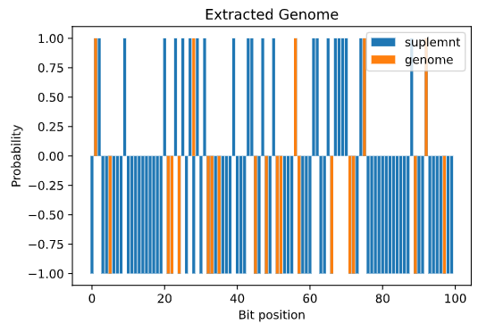
Checking genome performence
Keep genome
Improve gradually
Repeat for N samples checking in how many cases desired action occured.
Get changes

Slide 7
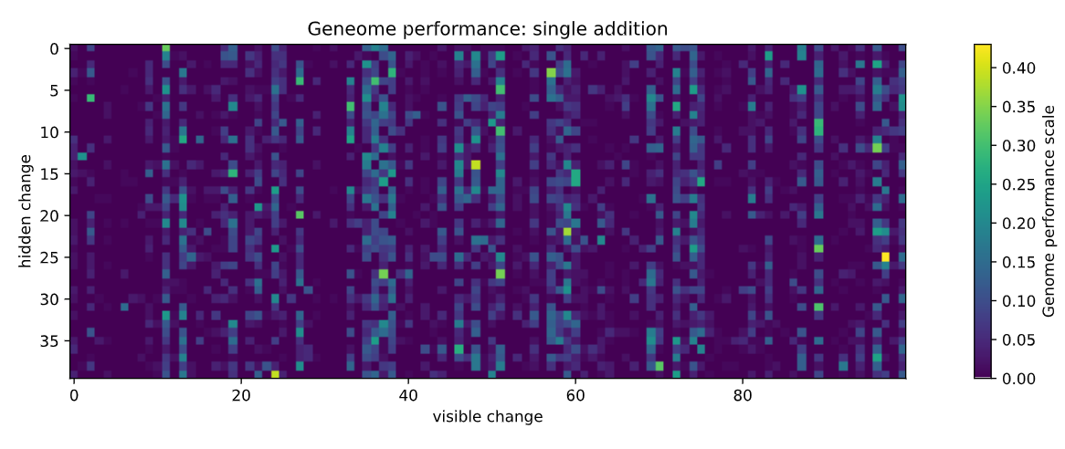
Genome performance: single addition

Slide 8
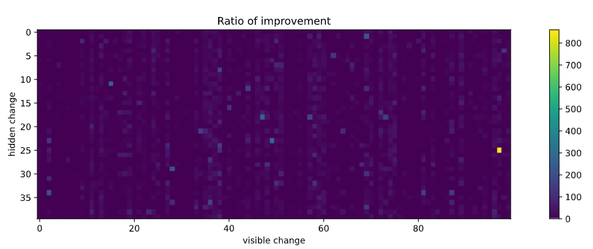
Ratio of improvement

